Slide 1
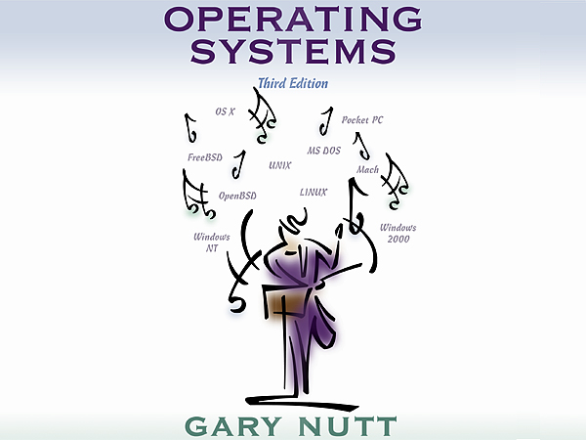
Operating Systems: A Modern Perspective, Chapter 10

Slide 2

Deadlock
10
Operating Systems: A Modern Perspective, Chapter 10

Slide 3
deadlock
cooperating processes are processes that cooperate to achieve a specific task.
Multiple cooperating processes introduce the potential for new synchronization problems in software implementation
  Critical section
  deadlock
Operating Systems: A Modern Perspective, Chapter 10

Slide 4
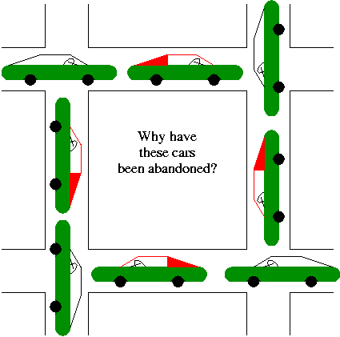
Real life eg:Automobile gridlock
Operating Systems: A Modern Perspective, Chapter 10

Slide 5
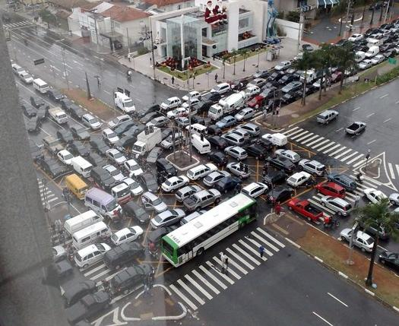
gridlock
Operating Systems: A Modern Perspective, Chapter 10

Slide 6
Example: computer science
Process 1
Process 2
Resource 1
Resource 2
Process holds the resource
Process requests the resource
Operating Systems: A Modern Perspective, Chapter 10

Slide 7
Three Deadlocked Processes
Process 1
Process 2
Process 3
Resource 1
Resource 2
Resource 3
Process holds the resource
Process requests the resource
Operating Systems: A Modern Perspective, Chapter 10

Slide 8
Addressing Deadlock
Prevention: Design the system so that deadlock is impossible
Avoidance: Construct a model of system states, then choose a strategy that will not allow the system to go to a deadlock state
Detection & Recovery: Check for deadlock (periodically or sporadically), then recover
Operating Systems: A Modern Perspective, Chapter 10

Slide 9
Prevention
Necessary conditions for deadlock
  Mutual exclusion
  Hold and wait
  Circular waiting
  No preemption
Ensure that at least one of the necessary conditions is false at all times
  Mutual exclusion must hold at all times
Operating Systems: A Modern Perspective, Chapter 10

Slide 10
Consider automobile grid lock: each section of the street as a resource
Mutual exclusion condition applies, since only one vehicle can be on a section of the street at a time.
Hold-and-wait condition applies, since each vehicle is occupying a section of the street, and waiting to move on to the next section of the street.
No-preemptive condition applies, since a section of the street that is a section of the street that is occupied by a vehicle cannot be taken away from it.
Circular wait condition applies, since each vehicle is waiting on the next vehicle to move. That is, each vehicle in the traffic is waiting for a section of street held by the next vehicle in the traffic.
Operating Systems: A Modern Perspective, Chapter 10

Slide 11
Hold and Wait
Need to be sure a process does not hold one resource while requesting another
Approach 1: Force a process to request all resources it needs at one time
Approach 2: If a process needs to acquire a new resource, it must first release all resources it holds, then reacquire all it needs
Operating Systems: A Modern Perspective, Chapter 10

Slide 12
Circular Wait
Have a situation in which there are K processes holding units of K resources
R
P
R_{i}
P holds R
P_{i}
P
R
P requests R
Operating Systems: A Modern Perspective, Chapter 10

Slide 13
Allowing Preemption
Allow a process to time-out on a blocked request -- withdrawing the request if it fails
r_{u}
S_{i}
S_{j}
w_{u}
d_{v}
r_{u}
S_{k}
Operating Systems: A Modern Perspective, Chapter 10

Slide 14
Avoidance
Define a model of system states, then choose a strategy that will guarantee that the system will not go to a deadlock state
Avoidance strategies are a conservative approach to resource allocation.
The strategy is to analyze a prospective state – before entering it – to guarantee that every process can still execute.
Operating Systems: A Modern Perspective, Chapter 10

Slide 15
Avoidance
It relies on resource manager’s ability to predict the effect of satisfying individual allocation requests.
  If a request can lead a situation in which a deadlock could occur , avoidance strategy will refuse the request.
  It is a predictive approach which relies on the information about the resource activity that will be occurring for the process
    Maximum claim
Operating Systems: A Modern Perspective, Chapter 10

Slide 16
Safe vs Unsafe States
Safe state: one in which the system can assure that any sequence of subsequent transitions leads back to the initial state
  Even if all exercise their maximum claim, there is an allocation strategy by which all claims can be met
Unsafe state: one in which the system cannot guarantee that the system will transition back to the initial state
  Unsafe state can lead to a deadlock state if too many processes exercise their maximum claim at once
Operating Systems: A Modern Perspective, Chapter 10

Slide 17
More on Safe & Unsafe States
I
Disallow
Safe States
Unsafe States
Deadlock States
Operating Systems: A Modern Perspective, Chapter 10

Slide 18
Banker’s algorithm
The banker’s algorithm is the classic avoidance strategy.
It is modeled after the lending policies employed in banking systems
  A bank has a limited amount of funds(resources) that can be lent to different borrowers(processes)
  To accommodate borrowers, the bank may extent a line of credit(pre-approved limit) to a customer
  Line of credit is a maximum claim for resources by the customer
Operating Systems: A Modern Perspective, Chapter 10

Slide 19
    At any moment loan department looks at the funds allocated to all customers and the maximum amount that can be requested by each customer.
    If there is some sequence of activity in which at least one customer’s full line of credit can be met, assume that the customer can borrow up to the line of credit and then repay the entire loan.
    After this customer has repaid the loan, the algorithm iterates on the other accounts
    If all customers can exercise their lines of credit and repay their loans, then the current state is safe.
Operating Systems: A Modern Perspective, Chapter 10

Slide 20
Avoidance
This strategy depends on additional information about the long-term resource needs of each process.
In particular, when a process is created, it must declare its maximum claim - the maximum number of units it will ever request – to every resource type.
The resource manager can honor the request if the resources are available
Operating Systems: A Modern Perspective, Chapter 10

Slide 21
Banker’s Algorithm
Let maxc[i, j] be the maximum claim for R_{j} by p_{i}
Let alloc[i, j] be the number of units of R_{j} held by p_{i}
Can always compute
  avail[j] = c_{j} - Σ_{0≤i< n}alloc[i,j]
  Then number of available units of R_{j}
Should be able to determine if the state is safe or not using this info
Operating Systems: A Modern Perspective, Chapter 10

Slide 22
Banker’s Algorithm
Copy the alloc[i,j] table to alloc’[i,j]
Given C, maxc and alloc’, compute avail vector
Find p_{i}: maxc[i,j] - alloc’[i,j] ≤ avail[j] for 0 ≤ j < m and 0 ≤ i < n.
  If no such p_{i} exists, the state is unsafe
  If alloc’[i,j] is 0 for all i and j, the state is safe
Set alloc’[i,j] to 0; deallocate all resources held by p_{i}; go to Step 2
Operating Systems: A Modern Perspective, Chapter 10

Slide 23
Example
Maximum Claim
C = <8, 5, 9, 7>
Process R₀ R₁ R₂ R₃
p₀ 3 2 1 4
p₁ 0 2 5 2
p₂ 5 1 0 5
p₃ 1 5 3 0
p₄ 3 0 3 3
Compute total allocated
Determine available units
avail = <8-7, 5-3, 9-7, 7-5>
= <1, 2, 2, 2>
Can anyone’s maxc be met?
Allocated Resources
maxc[2,0]-alloc’[2,0] = 5-4 = 1≤1 = avail[0]
maxc[2,1]-alloc’[2,1] = 1-0 = 1≤2 = avail[1]
maxc[2,2]-alloc’[2,2] = 0-0 = 0≤2 = avail[2]
maxc[2,3]-alloc’[2,3] = 5-3 = 2≤2 = avail[3]
Process R₀ R₁ R₂ R₃
p₀ 2 0 1 1
p₁ 0 1 2 1
p₂ 4 0 0 3
p₃ 0 2 1 0
p₄ 1 0 3 0
Sum 7 3 7 5
P₂ can exercise max claim
avail[0] = avail[0]+alloc’[2,0] = 1+4 = 5
avail[1] = avail[1]+alloc’[2,1] = 2+0 = 2
avail[2] = avail[2]+alloc’[2,2] = 2+0 = 2
avail[3] = avail[3]+alloc’[2,3] = 2+3 = 5
Operating Systems: A Modern Perspective, Chapter 10

Slide 24
Example
Maximum Claim
C = <8, 5, 9, 7>
Process R₀ R₁ R₂ R₃
p₀ 3 2 1 4
p₁ 0 2 5 2
p₂ 5 1 0 5
p₃ 1 5 3 0
p₄ 3 0 3 3
Compute total allocated
Determine available units
avail = <8-7, 5-3, 9-7, 7-5>
= <5, 2, 2, 5>
Can anyone’s maxc be met?
Allocated Resources
maxc[4,0]-alloc’[4,0] = 3-1 = 4≤5 = avail[0]
maxc[4,1]-alloc’[4,1] = 0-0 = 0≤2 = avail[1]
maxc[4,2]-alloc’[4,2] = 3-3 = 0≤2 = avail[2]
maxc[4,3]-alloc’[4,3] = 3-0 = 3≤5 = avail[3]
Process R₀ R₁ R₂ R₃
p₀ 2 0 1 1
p₁ 0 1 2 1
p₂ 0 0 0 0
p₃ 0 2 1 0
p₄ 1 0 3 0
Sum 3 3 7 2
P₄ can exercise max claim
avail[0] = avail[0]+alloc’[4,0] = 5+1 = 6
avail[1] = avail[1]+alloc’[4,1] = 2+0 = 2
avail[2] = avail[2]+alloc’[4,2] = 2+3 = 5
avail[3] = avail[3]+alloc’[4,3] = 5+0 = 5
Operating Systems: A Modern Perspective, Chapter 10

Slide 25
Example
Maximum Claim
C = <8, 5, 9, 7>
Process R₀ R₁ R₂ R₃
p₀ 3 2 1 4
p₁ 0 2 5 2
p₂ 5 1 0 5
p₃ 1 5 3 0
p₄ 3 0 3 3
Compute total allocated
Determine available units
avail = <8-7, 5-3, 9-7, 7-5>
= <6, 2, 5, 5>
Can anyone’s maxc be met? (Yes, any of them can)
Allocated Resources
Process R₀ R₁ R₂ R₃
p₀ 2 0 1 1
p₁ 0 1 2 1
p₂ 0 0 0 0
p₃ 0 2 1 0
p₄ 0 0 0 0
Sum 2 1 4 2
Operating Systems: A Modern Perspective, Chapter 10

Slide 26
Detection & Recovery
Check for deadlock (periodically or sporadically), then recover
Can be far more aggressive with allocation
No maximum claim, no safe/unsafe states
Differentiate between
  Serially reusable resources: A unit must be allocated before being released
  Consumable resources: Never release acquired resources; resource count is number currently available
Operating Systems: A Modern Perspective, Chapter 10

Slide 27
Recovery
No magic here
  Choose a blocked resource
    Preempt it (releasing its resources)
    Run the detection algorithm
    Iterate if until the state is not a deadlock state
  May use resource graph to select processes to destroy.
  Operator simply begins destroying processes untill the system appears to be operational again
  Brute force is to reboot the entire machine
Operating Systems: A Modern Perspective, Chapter 10

